Slide 1


Glenn Ross-Dolan
M.Sc. Bioinformatics and Computational Biology
“Single-cell transcriptomics of intestinal epithelial cells: Insights into the prediabetic condition”
Supervised By:
Silvia Melgar

Slide 2
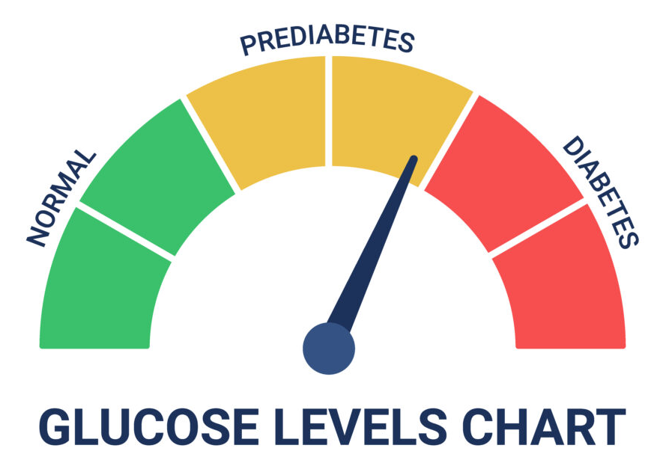
Prediabetes & T2DM
Global health crisis, T2DM prevalence x4 in last 30 years.
Characterised by: insulin resistance, inadequate insulin secretion, leads to hyperglycaemia.
Usually preceded by prediabetes. (Impaired fasting glucose, Impaired glucose tolerance, raised HbA1c levels).
Associated with: obesity, diet, sedentary lifestyle, genetic factors.
Systemic effects of T2DM and prediabetes are well documented, although emerging evidence is highlighting the role of the intestinal epithelium in the development of prediabetes.

Slide 3
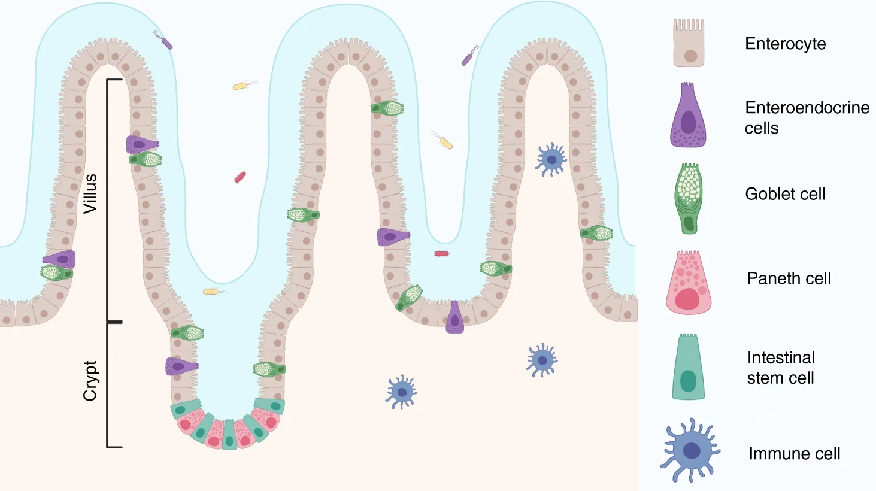
Project Aim
Why?
Complement of another study
Allows for the selection of biological targets for further study of seaweed extract.
Find altered genes/pathways in the individual intestinal cell types which are characteristic of the prediabetic subject.
Intestinal Epithelium
Image adapted from: https://www.nature.com/articles/s41467-020-20052-z/figures/1

Slide 4
How?
Choose suitable data
Review literature for best analysis practices
Build an analysis pipeline
Carry out the analysis
Review the findings
Form a biological hypothesis
Build onto the current literature

Slide 5
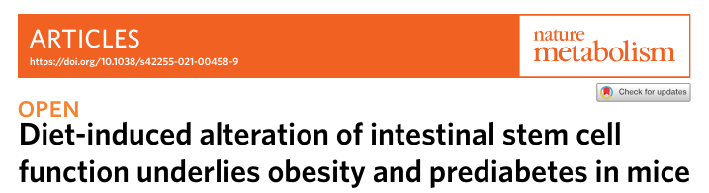


Experimental Model
https://www.nature.com/articles/s42255-021-00458-9
Mice assigned to one of two diets for 12 weeks, until 24 weeks old.
Prediabetic status evaluated.
Intestinal tissue taken and sequenced at the single cell resolution.
Control Diet
High Fat/High Sugar Diet
Week 0
Week 12
Week 24

Slide 6


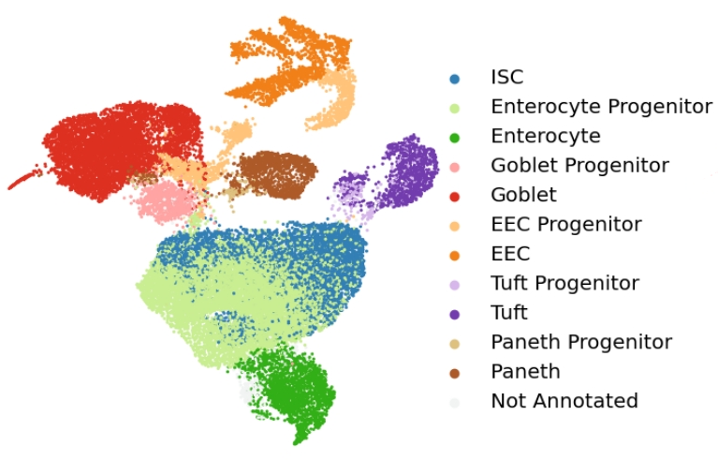
The Upstream Pipeline
A series of automated, sequential steps for processing and analysing biological data, ensuring efficient and reproducible workflows.
Raw Data
(Count Table)
Data Cleaning
Quality Control
Doublet Removal
kNN/UMAP
PCA
Feature Selection
Normalisation
Annotated data table ✅
Clustering
Cell Annotation

Slide 7
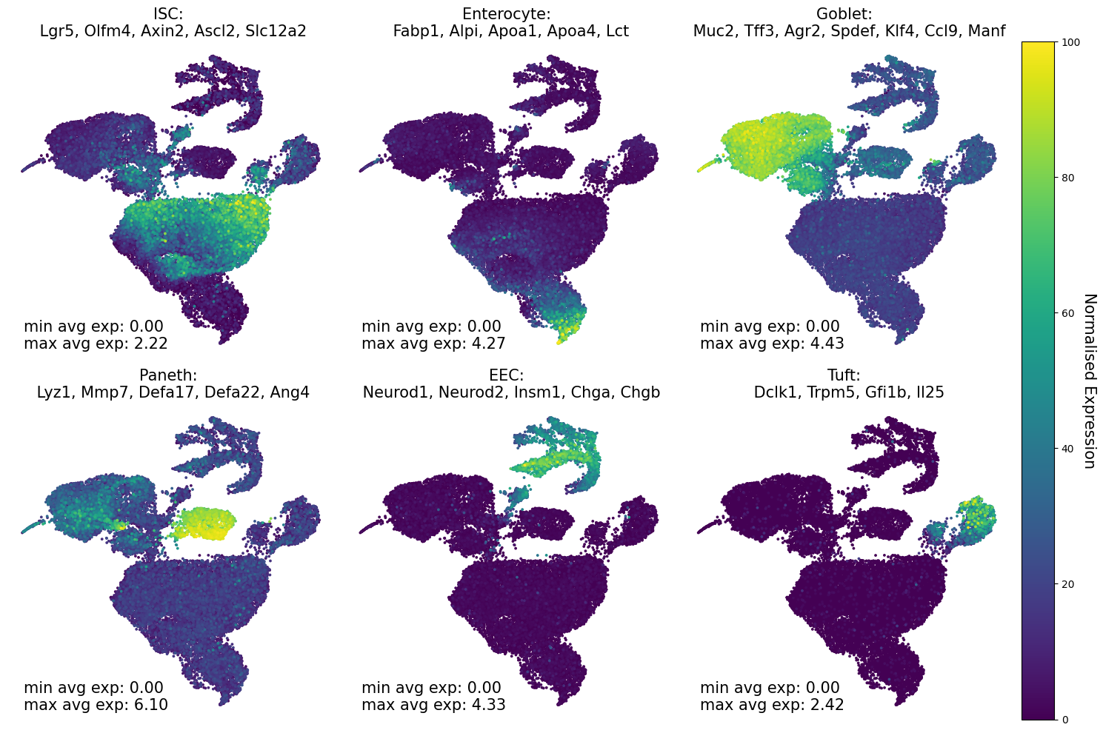
Annotated dataset
27,419 cells (13,363 Control Diet, 14,056 High-fat high-sugar Diet)
6 main cell types, with respective progenitor cell types.

Slide 8
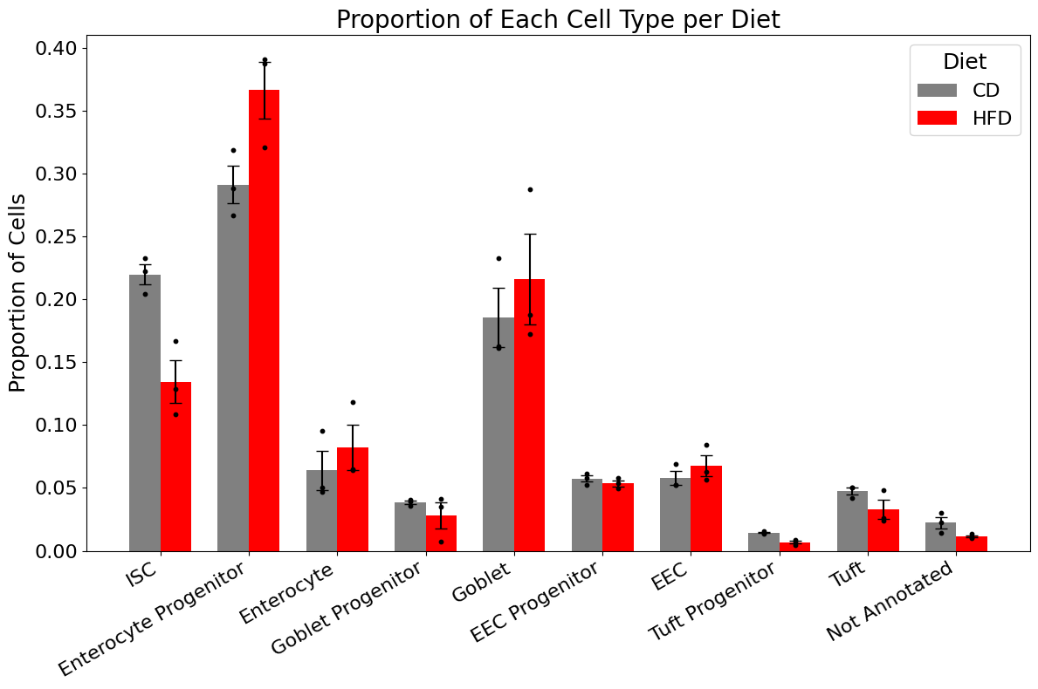
Cell Type Proportions

Slide 9


The Downstream Pipeline
GO Enrichment
GO Enrichment Visualisation
Annotated Data Table
DGE Analysis
KEGG Enrichment Analysis
Further KEGG Pathway Analysis
Abbreviations:
DGE: Differential Gene Expression
GO: Gene Ontology
KEGG: Kyoto Encyclopedia of Genes and Genomes

Slide 10
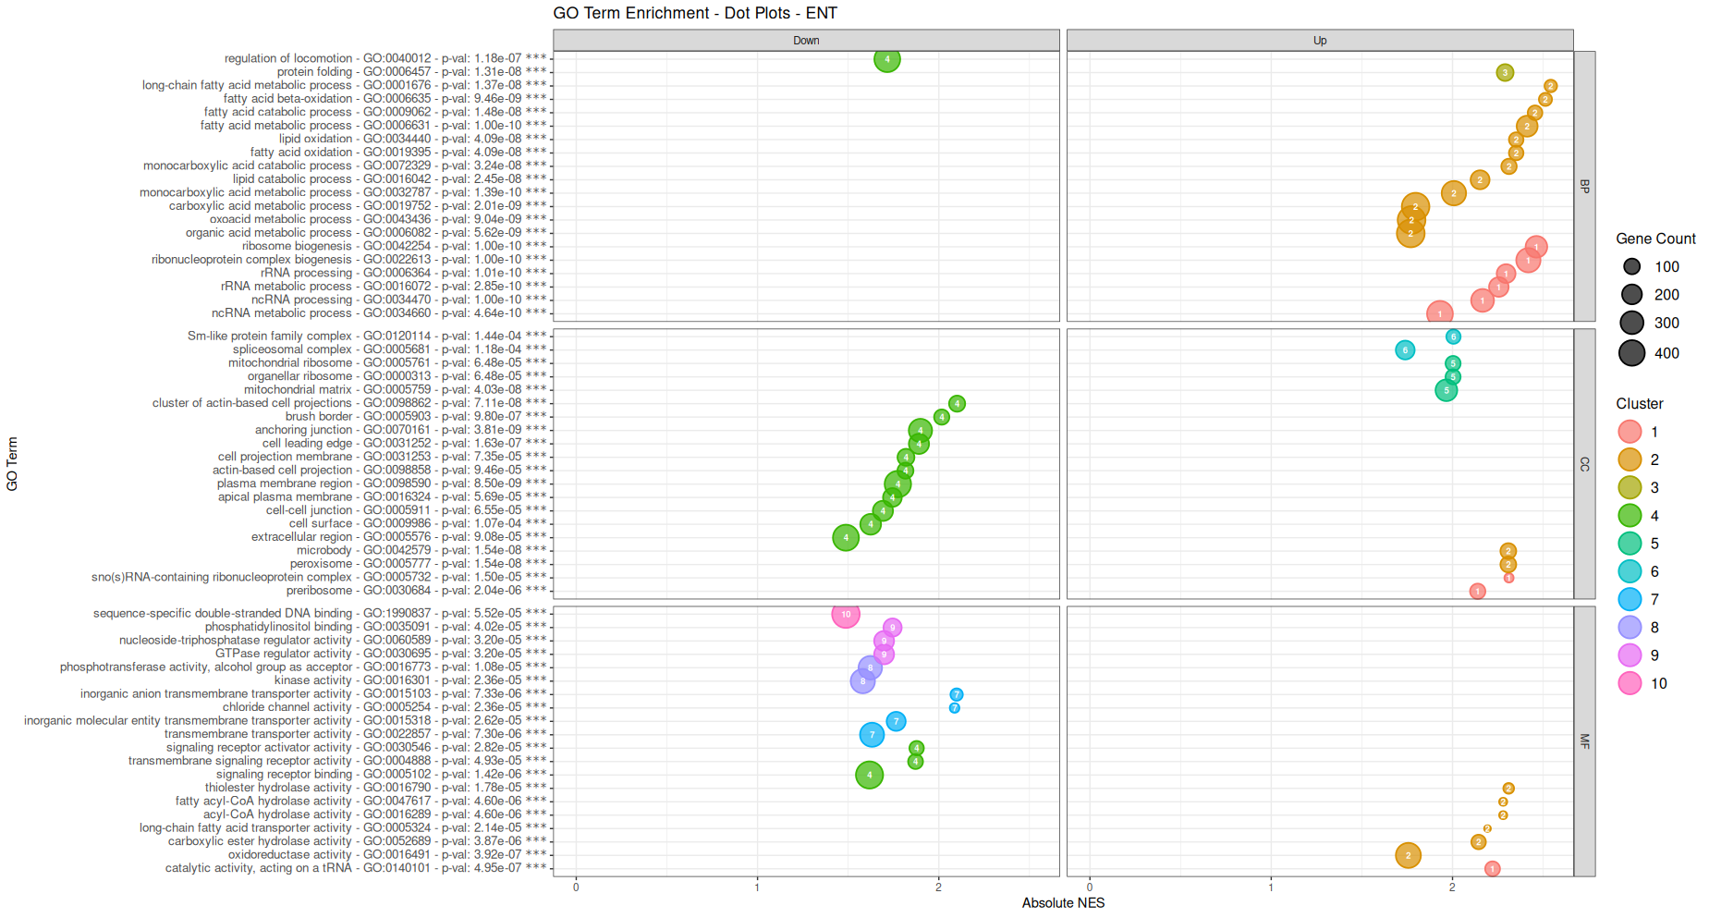
Gene Set Enrichment - Gene Ontology

Slide 11
GO Enrichment - What did we find?
Intestinal Stem Cells
↑ Cell cycle, chromosome dynamics, and DNA replication processes across biological processes, cellular components, and molecular functions.
↑ Mitochondrial function
↓ Adherens junctions (paracellular barrier)
Enterocytes
↑ lipid metabolism processes
↓ cell adhesion and signalling (paracellular barrier)
↓ calcium-dependent protein binding

Slide 12
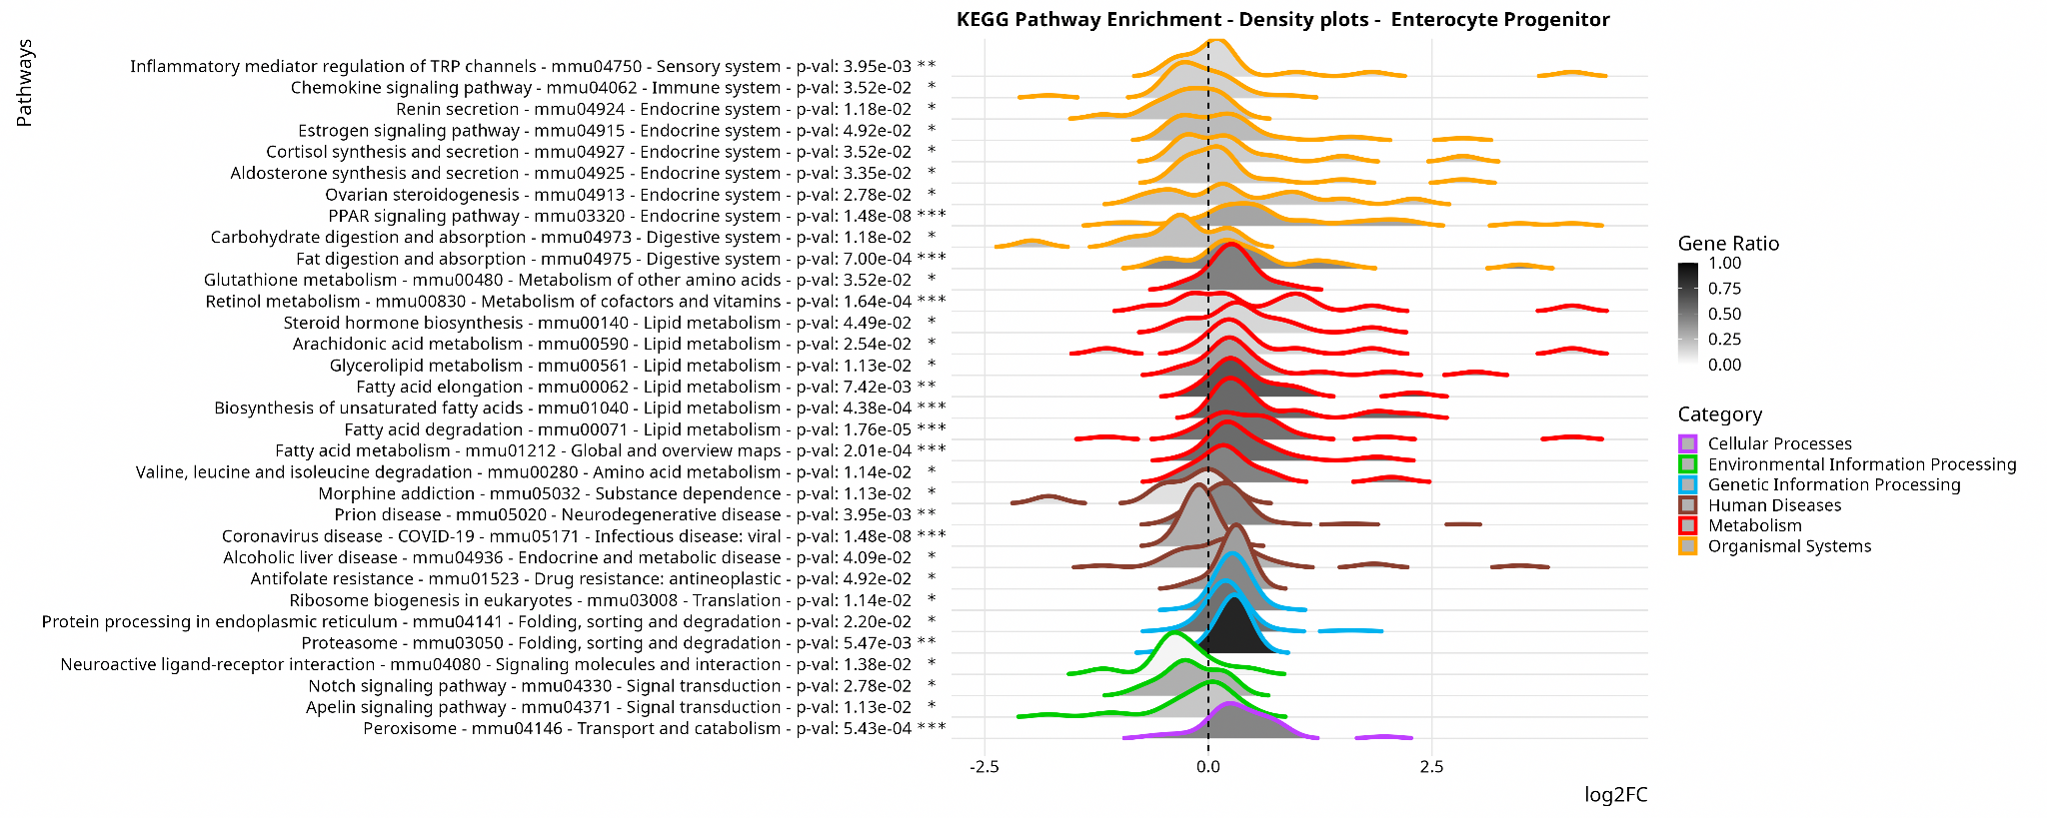
Gene Set Enrichment

Slide 13
KEGG Enrichment - What did we find?
Intestinal Stem Cells
↑ Cell Cycle
↓ Cell adhesion molecules pathway (Paracellular Junction)
↑ Fatty acid metabolism pathway
Enterocytes
↓ Carbohydrate Digestion and absorption
↑ Lipid metabolism and digestion pathways
↑ Protein processing in the endoplasmic reticulum
↑ Proteasome

Slide 14
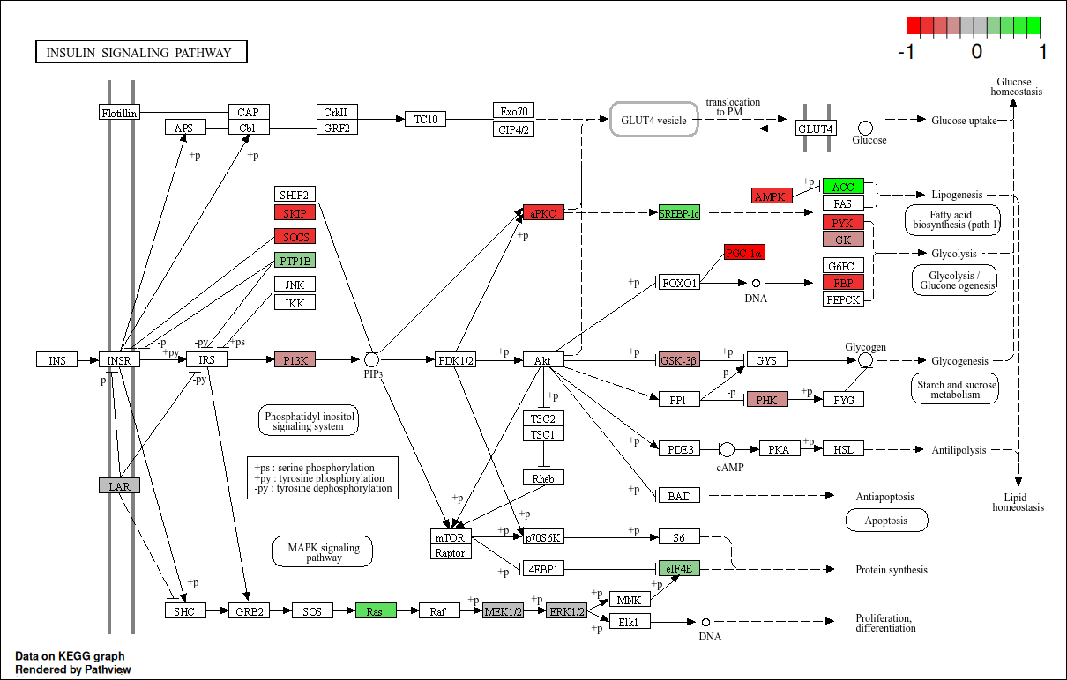
HFHSD alters macronutrient metabolism in the IE layer
Srebp1-c transcriptional regulator is upregulated
Involved in lipid metabolism and glycolysis

Slide 15
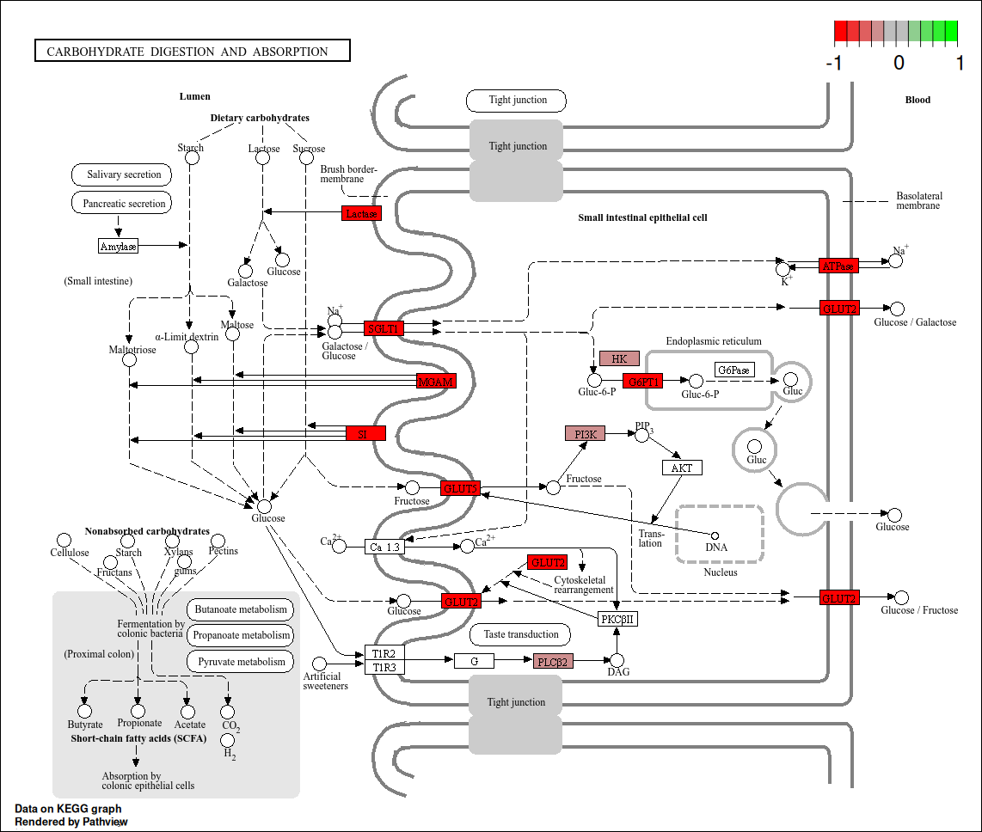
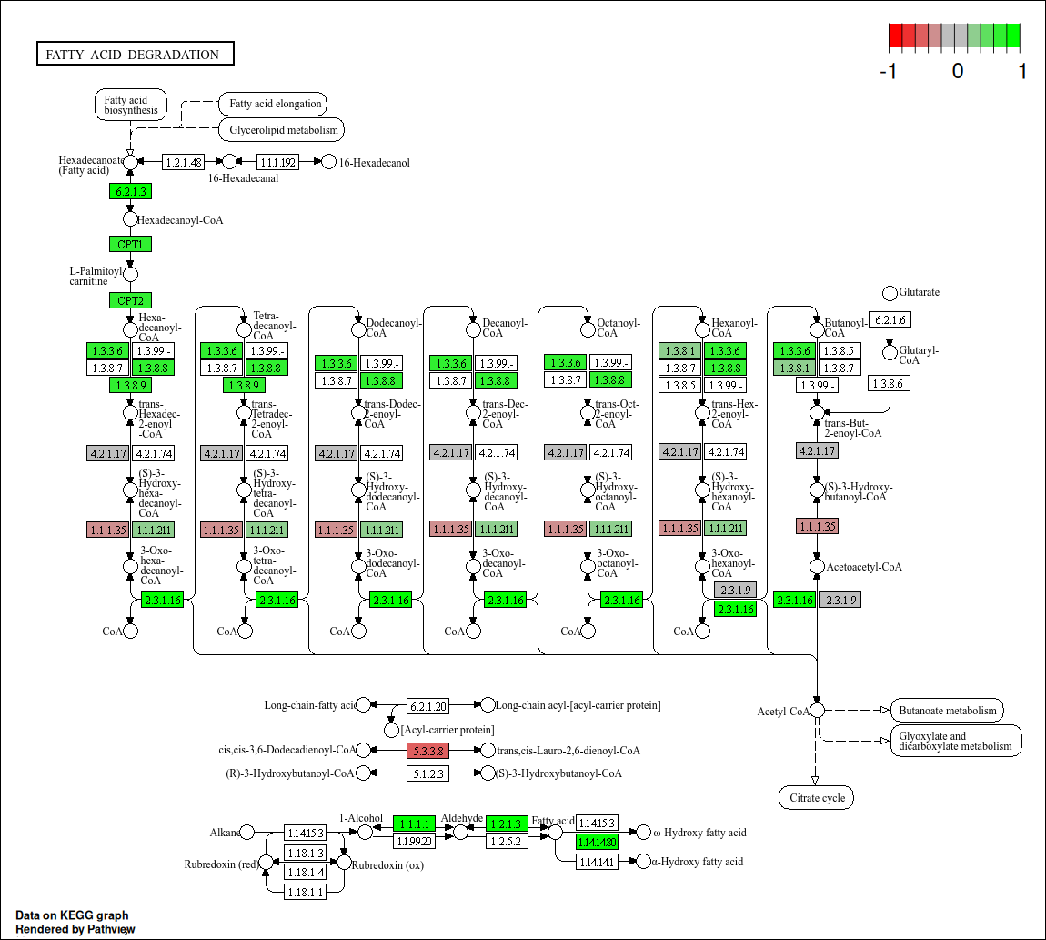
Carbohydrate / Fatty Acid Metabolism alterations
Enterocytes shift from carbohydrate utilisation to lipid utilisation

Slide 16
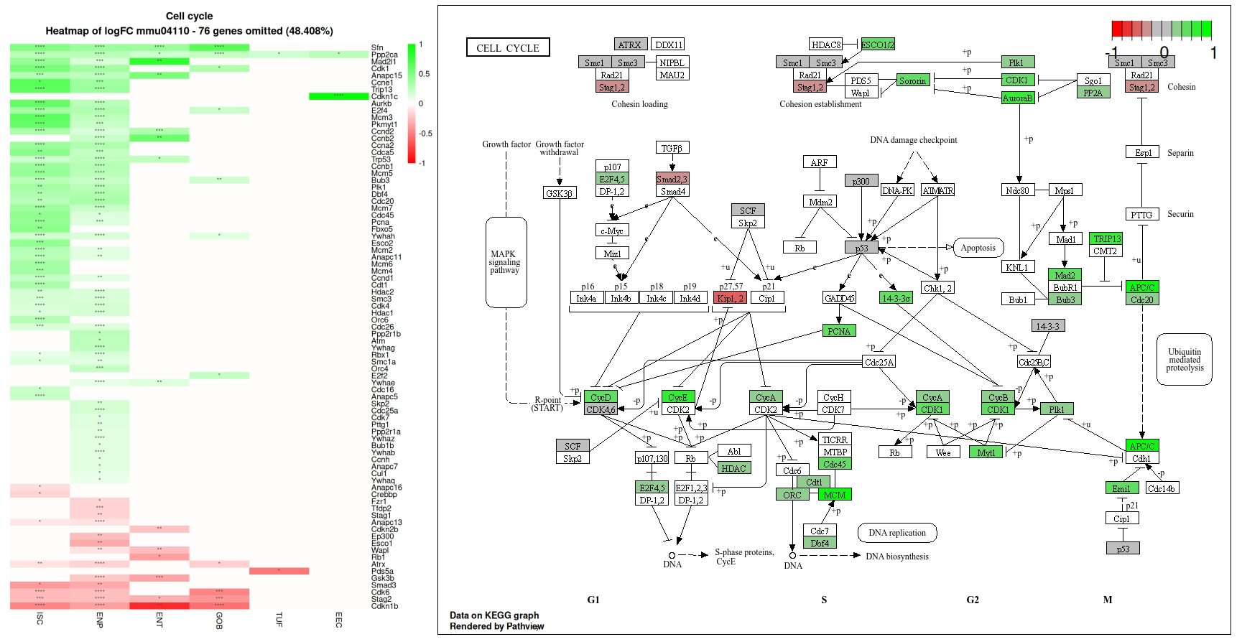
HFHSD induces hyperproliferation through upregulation of the cell cycle.

Slide 17
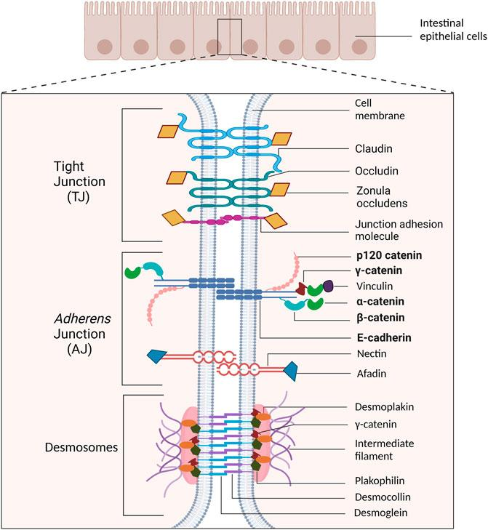
Barrier Permeability & Inflammation
Systemic inflammation in prediabetes is characterised by elevated levels of inflammatory markers and alterations in immune function
Inflammation during the prediabetic state seems to be a driving force behind pancreatic beta cell dysfunction, insulin resistance, dyslipidemia, and cardiovascular diseases and is a risk factor for peripheral vascular diseases
Emerging evidence is linking ‘leaky gut’ to inflammation, we decided to test this hypothesis in an attempt to clarify conflicts in the literature.
Notes:
Inflammation plays a crucial role in the pathogenesis of prediabetes and its progression to
T2DM in the larger systemic context. Systemic inflammation in prediabetes is
characterised by elevated levels of inflammatory markers and alterations in immune
function (Weaver et al., 2021) Inflammation during the
prediabetic state seems to be a driving force behind pancreatic beta cell dysfunction,
insulin resistance, dyslipidemia, and cardiovascular diseases and is a risk factor for
peripheral vascular diseases (Saghir et al., 2023) Initiation of inflammation in the
prediabetic subject is not fully understood, although research is suggesting that it may
begin in the intestines. In the context of intestinal inflammation in prediabetes, recent hypotheses are focussed on
the relationship between diet, gut microbiota, and intestinal barrier function. One prevalent
hypothesis suggests that high-fat diet intake leads to alterations in intestinal microbiota
composition. These alterations are thought to increase paracellular permeability and
absorption of lipopolysaccharide (LPS), dietary antigens, and translocation of bacteria
leading to metabolic endotoxemia and low-grade chronic systemic inflammation, which
8
may trigger or exacerbate peripheral insulin resistance (Geurts et al., 2014; Gomes et al.,
2017; Nascimento et al., 2021).

Slide 18
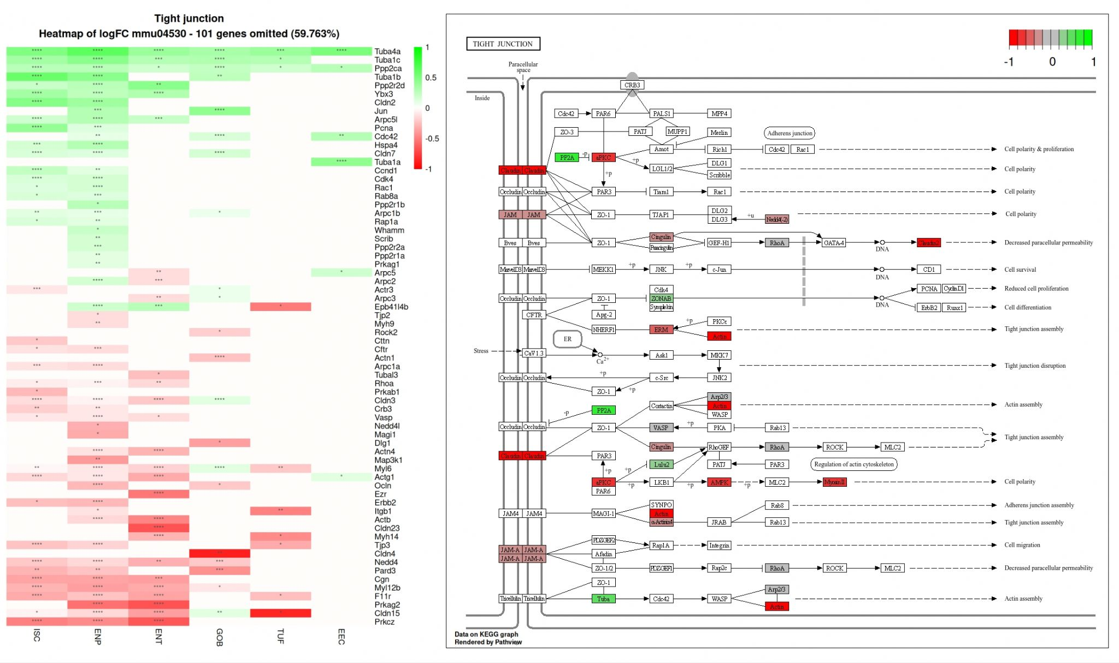
Intestinal Barrier Integrity

Slide 19
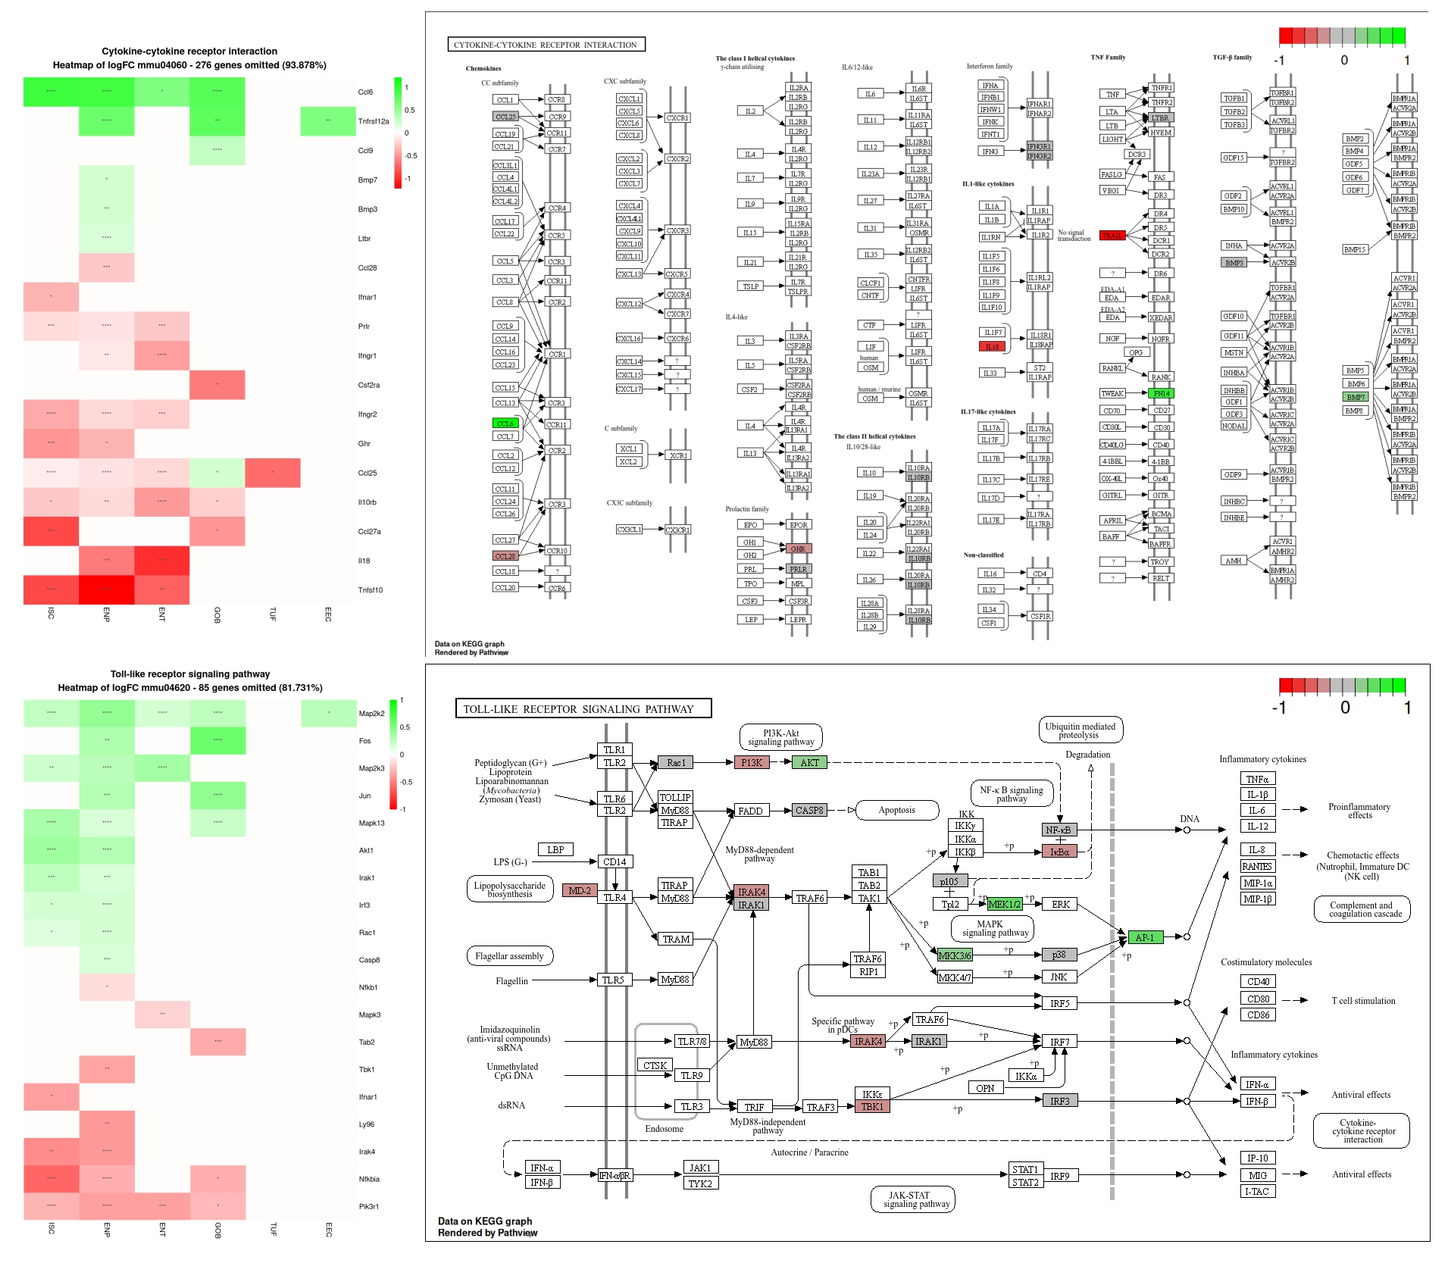
Inflammation
Detection of inflammation was inconclusive

Slide 20
Inflammation
Detection of inflammation was inconclusive
Notes:
Inflammation plays a crucial role in the pathogenesis of prediabetes and its progression to
T2DM in the larger systemic context. Systemic inflammation in prediabetes is
characterised by elevated levels of inflammatory markers and alterations in immune
function (Weaver et al., 2021) Inflammation during the
prediabetic state seems to be a driving force behind pancreatic beta cell dysfunction,
insulin resistance, dyslipidemia, and cardiovascular diseases and is a risk factor for
peripheral vascular diseases (Saghir et al., 2023) Initiation of inflammation in the
prediabetic subject is not fully understood, although research is suggesting that it may
begin in the intestines. In the context of intestinal inflammation in prediabetes, recent hypotheses are focussed on
the relationship between diet, gut microbiota, and intestinal barrier function. One prevalent
hypothesis suggests that high-fat diet intake leads to alterations in intestinal microbiota
composition. These alterations are thought to increase paracellular permeability and
absorption of lipopolysaccharide (LPS), dietary antigens, and translocation of bacteria
leading to metabolic endotoxemia and low-grade chronic systemic inflammation, which
8
may trigger or exacerbate peripheral insulin resistance (Geurts et al., 2014; Gomes et al.,
2017; Nascimento et al., 2021).

Slide 21
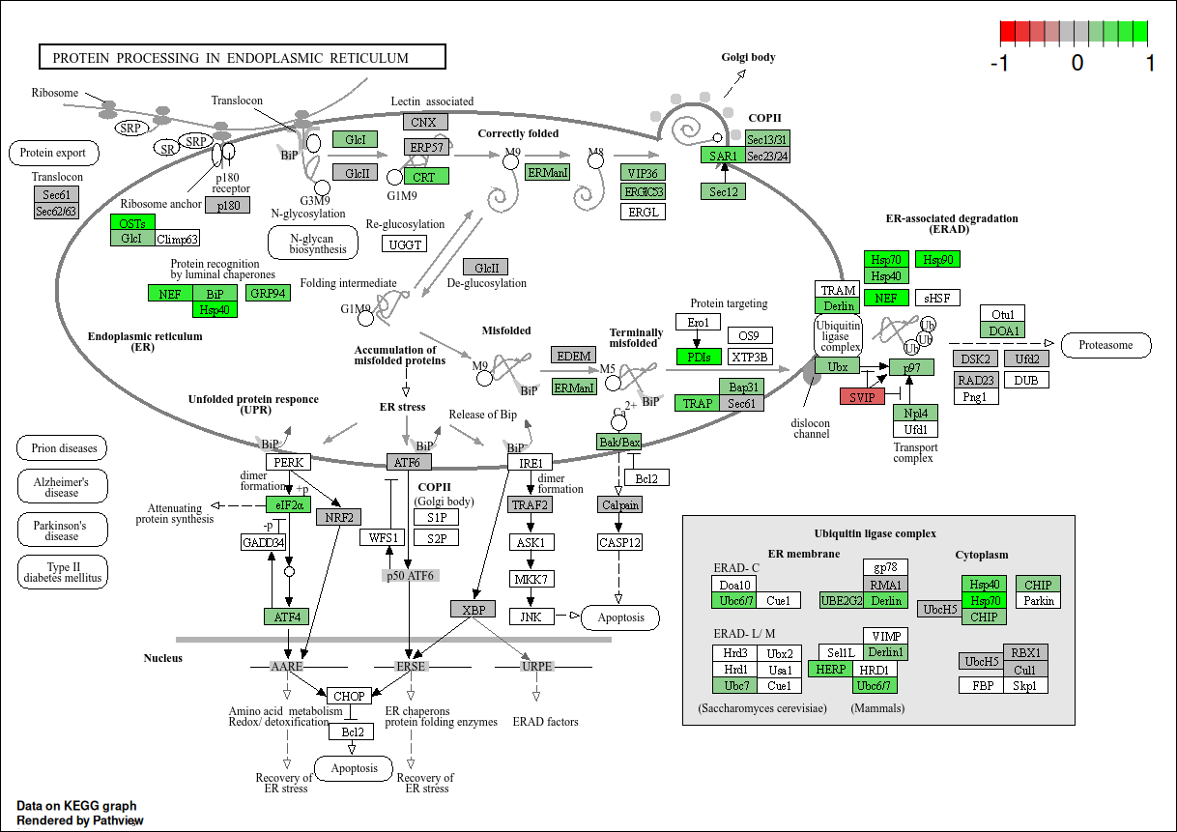
ER Stress
ER stress is induced by three pathways: PERK, ATF6, IRE1
We detected an upregulation of the PERK pathway.
Widespread upregulation of ER Stress pathways.
Perhaps helps to correct impaired intestinal barrier.

Slide 22
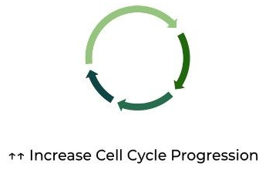
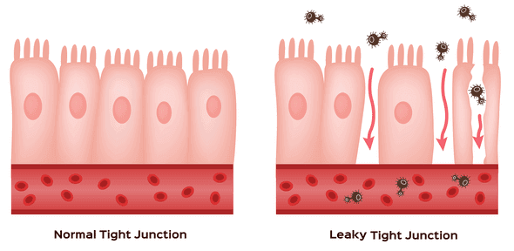
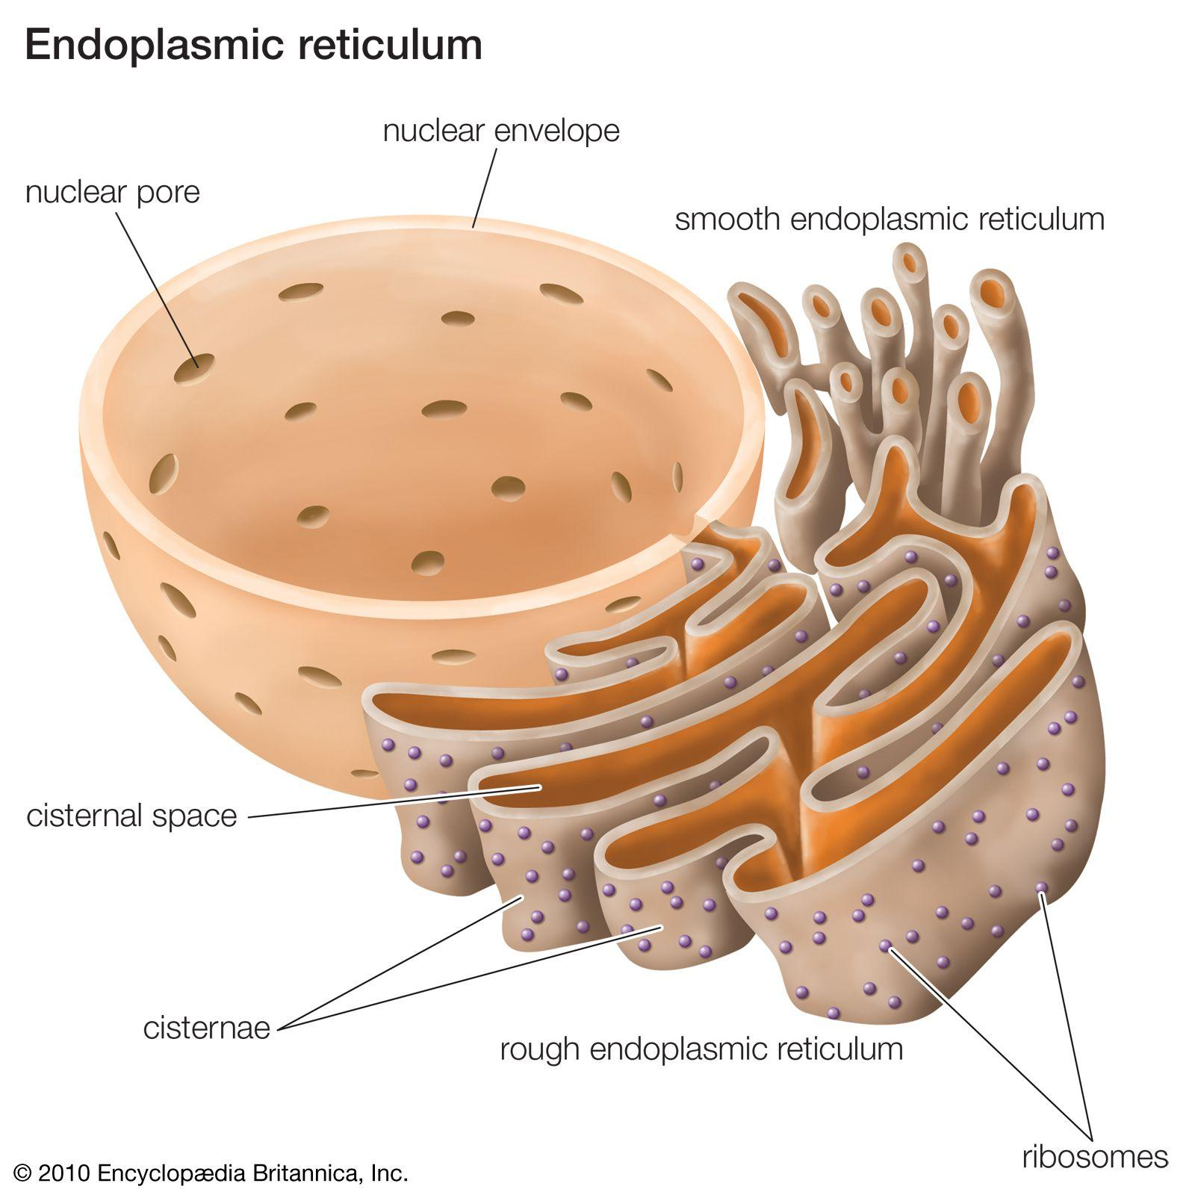
Conclusions
Intestinal Stem Cell - Cell Cycle is increased resulting in faster turnover of the IE layer
Enterocytes shift from carbohydrate utilisation to fat utilisation for energy.
Intestinal Barrier Integrity is impaired although there is no evidence to support that this leads to inflammation.
ER stress is induced by HFHSD perhaps to deal with
Carbs → Fats

Slide 23
Thank you!

